Slide 1
Binary Search
2023.02.01
Hailey

Slide 2


Slide 3
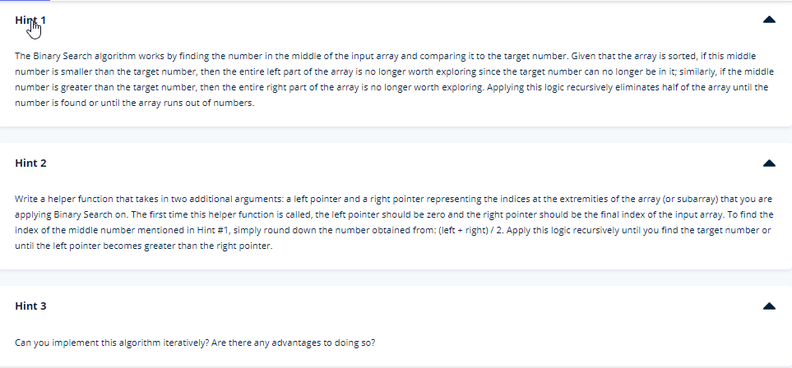

Slide 4
